Slide 1
What’s new in Plug-in Development?
“In PDE we do tooling, but our business is people”
Chris Aniszczyk <zx@eclipsesource.com>
EclipseSource
PDE Co-Lead and Technology PMC Member
What’s new in Plug-in Development? | Chris Aniszczyk | © 2008 EclipseSource
Notes:
Note: Mention that this is focused on plug-in development, not building plug-ins

Slide 2
Agenda
The Past (Ganymede)
The Future (Galileo)
Q&A
What’s new in Plug-in Development? | Chris Aniszczyk | © 2008 EclipseSource

Slide 3
Agenda
The Past (Ganymede)
The Future (Galileo)
Q&A
What’s new in Plug-in Development? | Chris Aniszczyk | © 2008 EclipseSource

Slide 4
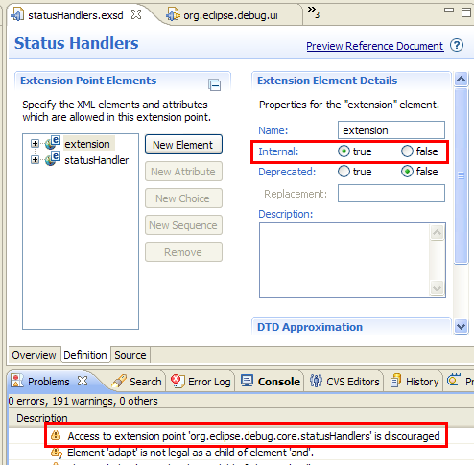
Internal Extension Points
Extension points can be marked as internal now, similar to how you mark packages internal
What’s new in Plug-in Development? | Chris Aniszczyk | © 2008 EclipseSource

Slide 5
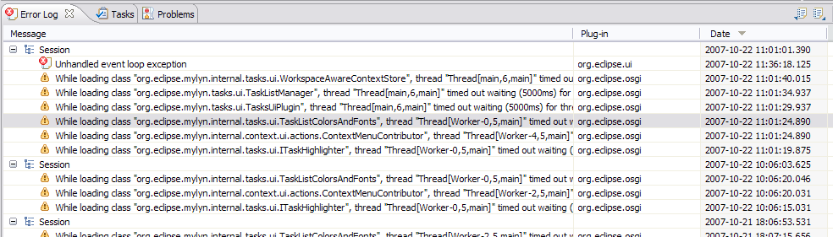
Error Log Enhancements
More than meets the eye… browse launch configuration logs...
Group log entries by
  Session
  Plug-in
What’s new in Plug-in Development? | Chris Aniszczyk | © 2008 EclipseSource

Slide 6
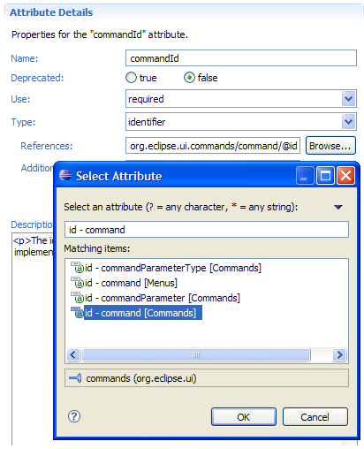
Schema Identifiers
A new type was introduced in extension points: identifier
Identifiers allow you to reference other extensions
e.g., perspective extensions refer to a perspective id that is defined in another extension point
What’s new in Plug-in Development? | Chris Aniszczyk | © 2008 EclipseSource

Slide 7
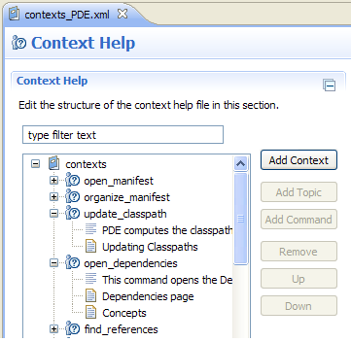
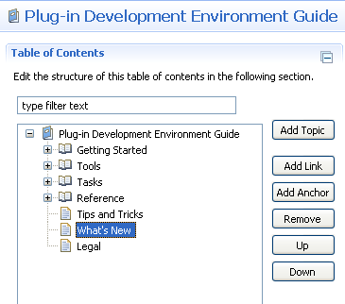
New User Assistance Editors
Table of Contents Editor
Context Help Editor
What’s new in Plug-in Development? | Chris Aniszczyk | © 2008 EclipseSource

Slide 8
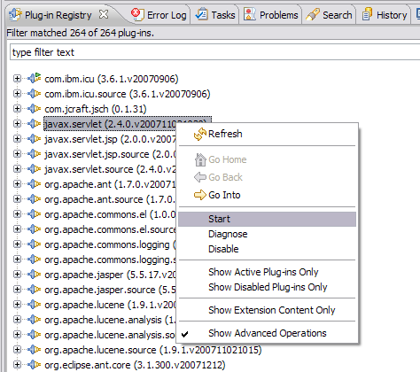
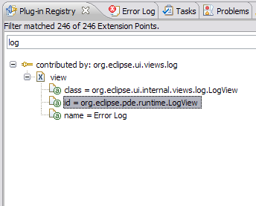
Plug-in Registry View Enhancements
The Plug-in Registry view is your eye into the runtime
Show Advanced Operations
  start/stop bundles
Show Extension Content Only
  quickly browse extensions
What’s new in Plug-in Development? | Chris Aniszczyk | © 2008 EclipseSource

Slide 9
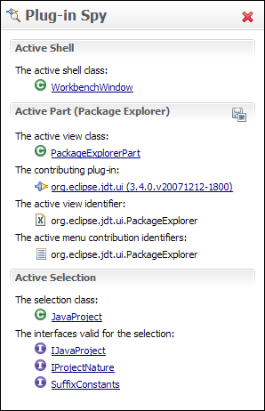
Plug-in Spy (3.4M3)
ALT+SHIFT+F1
Allows you to introspect what you’re looking at…
Hyperlinking
Shows contributing plug-ins
What’s new in Plug-in Development? | Chris Aniszczyk | © 2008 EclipseSource

Slide 10
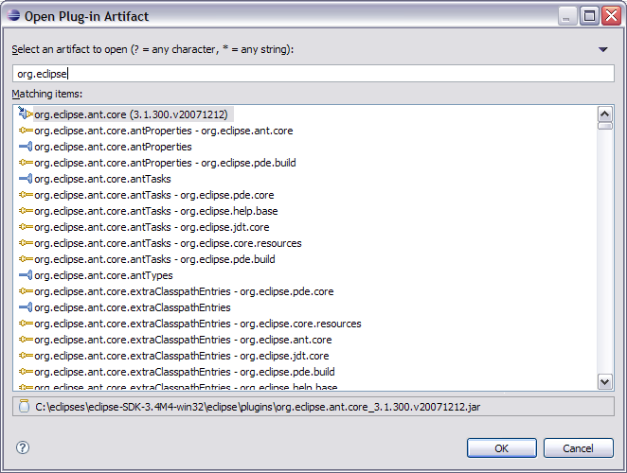
Open Plug-in Artifact (3.4M4)
Ctrl+Shift+A
Quickly browse plug-ins, extensions and extension points, features (3.5)
What’s new in Plug-in Development? | Chris Aniszczyk | © 2008 EclipseSource

Slide 11
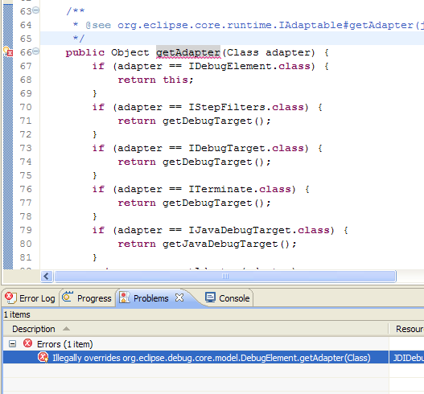
API Tooling (3.4M6)
API tooling will assist developers in API maintenance by reporting…
  API defects such as binary incompatibilities
  incorrect plug-in version numbers
  missing or incorrect @since tags
  usage of non-API code between plug-ins
What’s new in Plug-in Development? | Chris Aniszczyk | © 2008 EclipseSource

Slide 12
Agenda
The Past (Ganymede)
The Future (Galileo)
Q&A
What’s new in Plug-in Development? | Chris Aniszczyk | © 2008 EclipseSource

Slide 13

*EE Library Validation Access (3.5M5)
Validate references to system library based on EE (J2SE-1.4, etc).
A 1.4 project should not reference 1.5/1.6 methods/classes
Targetting 1.4... or lower...
  and use Boolean.parseBoolean(String)... @#%^!
  and use StringBuilder... new String(StringBuilder)... W#$%
What’s new in Plug-in Development? | Chris Aniszczyk | © 2008 EclipseSource

Slide 14
*API Tooling for Extension Registry (3.5M5)
  What do you consider API in extensions?
  View ids? Perspective ids?
  Goal is to provide same functionality as we have for Java but for extensions
What’s new in Plug-in Development? | Chris Aniszczyk | © 2008 EclipseSource

Slide 15
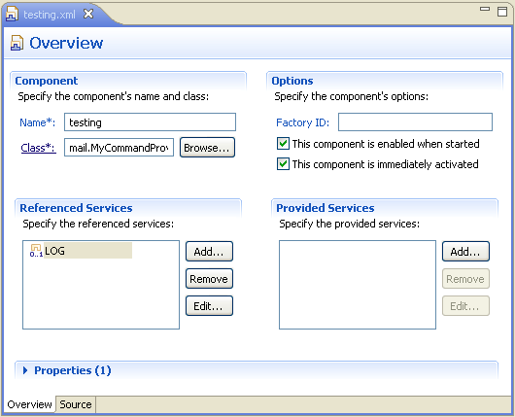
Declarative Services Tooling (3.5M2)
DS Tooling
  Editor
  Validation
  Code Completion
  Sample Templates
What’s new in Plug-in Development? | Chris Aniszczyk | © 2008 EclipseSource

Slide 16
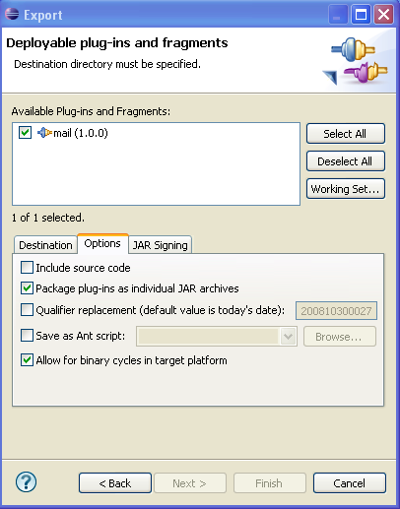
Binary Cycles (3.5M3)
PDE UI and Build supports binary cycles in the target platform
  Note: PDE Build supports this in 3.4
What’s new in Plug-in Development? | Chris Aniszczyk | © 2008 EclipseSource

Slide 17
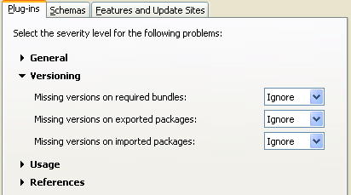
Versioning Checks (3.5M3)
PDE can now help you validate information around versions
What’s new in Plug-in Development? | Chris Aniszczyk | © 2008 EclipseSource

Slide 18
Parallel Compliation (3.5M3)
PDE Build now supports parallel compilation
  parallelCompilation=true in your top-level build.properties file
What’s new in Plug-in Development? | Chris Aniszczyk | © 2008 EclipseSource

Slide 19
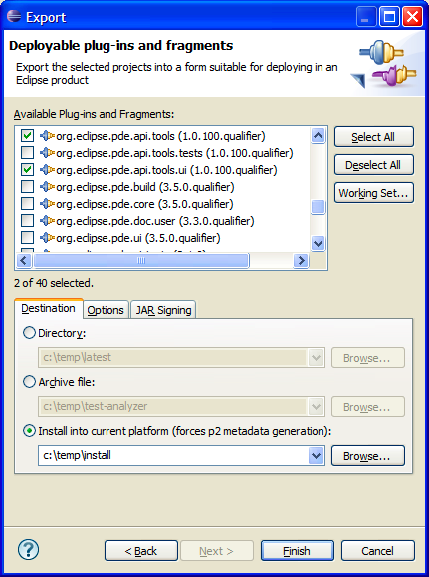
Export to Running Instance (3.5M3)
PDE now supports exporting to the current running platform
What’s new in Plug-in Development? | Chris Aniszczyk | © 2008 EclipseSource

Slide 20
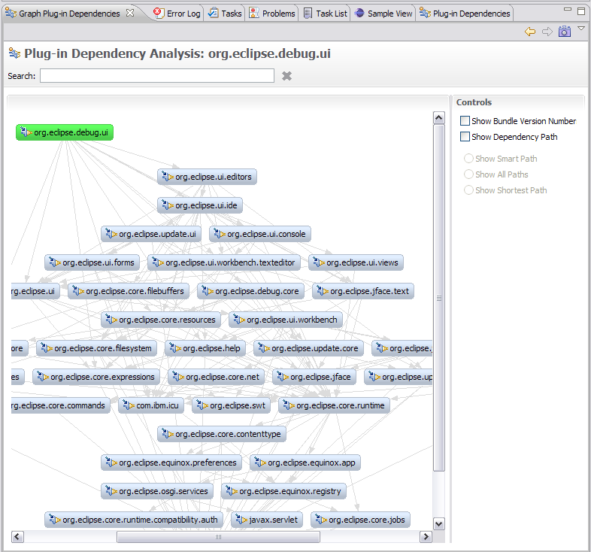
*Graph Plug-in Dependencies View (3.5M5)
PDE Incubator Project
Visualize your dependencies
Pictures are worth a thousand words
Looking to graduate in 3.5
* http://www.eclipse.org/pde/incubator/dependency-visualization/
What’s new in Plug-in Development? | Chris Aniszczyk | © 2008 EclipseSource

Slide 21
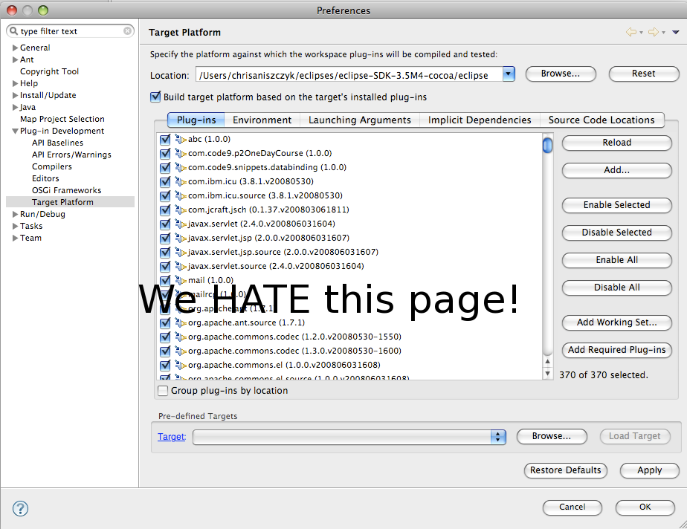
*Target Management Improvements (3.4M5)
What’s new in Plug-in Development? | Chris Aniszczyk | © 2008 EclipseSource

Slide 22
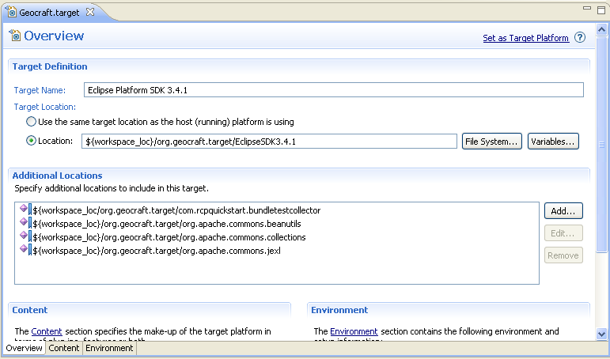
*Target Management Improvements (3.4M5)
Target definitions to be used by default
*Target itself will be managed by p2
*Target can be self-provisioned using p2
What’s new in Plug-in Development? | Chris Aniszczyk | © 2008 EclipseSource

Slide 23
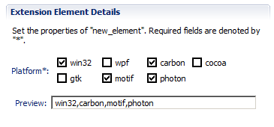
Custom Schema Types (3.5M5)
Currently, there are five types of attribute types:
  Resource
  Java
  Identifer
  String
  Boolean
This will allow people to plug-in their own types in... what does that mean?
What’s new in Plug-in Development? | Chris Aniszczyk | © 2008 EclipseSource

Slide 24
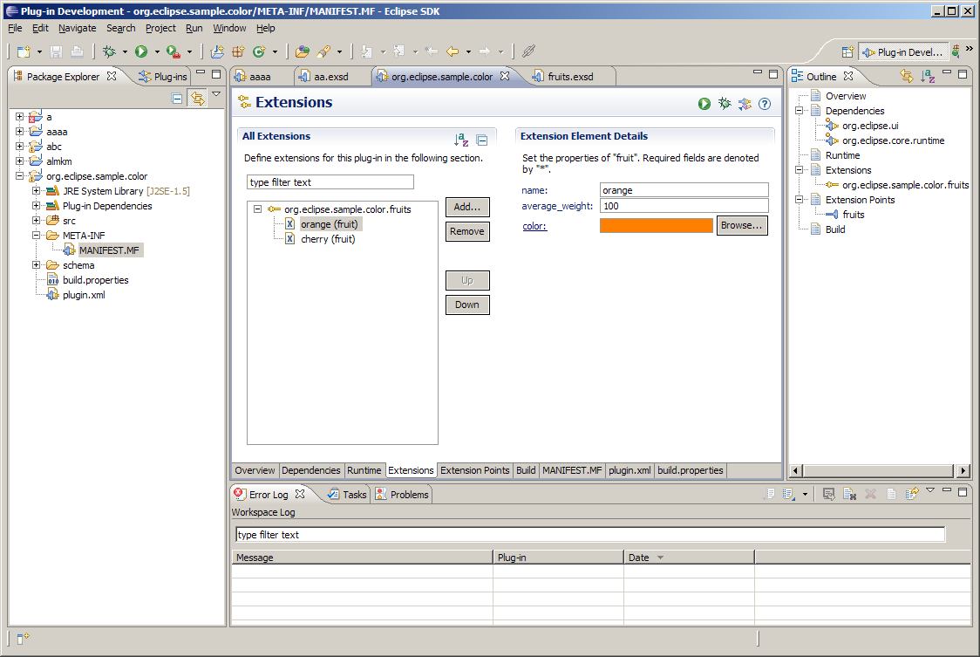
What’s new in Plug-in Development? | Chris Aniszczyk | © 2008 EclipseSource

Slide 25
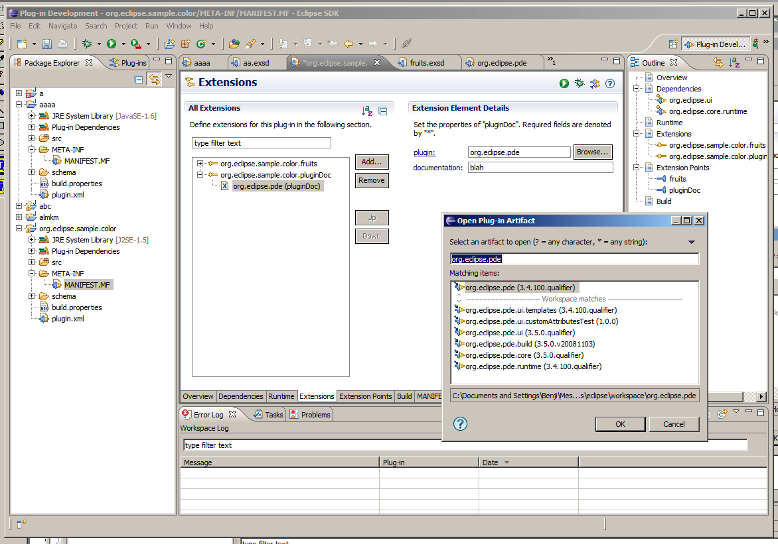
What’s new in Plug-in Development? | Chris Aniszczyk | © 2008 EclipseSource

Slide 26

Conclusion
http://www.eclipse.org/pde
PDE is only as good as you want it to be... so please file bugs for influence!
Want to contribute?
  PDE Bug Day
  http://wiki.eclipse.org/BugDay
Thank you!
What’s new in Plug-in Development? | Chris Aniszczyk | © 2008 EclipseSource

Slide 27
Questions?
Suggestions?
Requests?
What’s new in Plug-in Development? | Chris Aniszczyk | © 2008 EclipseSource

Slide 28
Suggestion Box
?
?
?
?
?
?
What’s new in Plug-in Development? | Chris Aniszczyk | © 2008 EclipseSource

